Slide 1

CS6611 – CREATIVE AND INNOVATIVE PROJECT
ELECTION SENTIMENT ANALYSIS
Done by,
R A Nithish Kumar – 2021103548
Aravind Krishnan S – 2021103509
T V Pavishek – 2021103721

Slide 2
PROBLEM STATEMENT
Traditional methods like polls struggle to capture the real time pulse of public opinion during elections .
Social media offers a massive dataset , but analysing it efficiently is difficult due to volume , complexity and bias.
This research develops and applies advanced NLP techniques like sentiment analysis to automatically classify and analyse opinions expressed in election-related tweets.
Sentiment analysis can automatically classify opinions(positive,negative,neutral) expressed in election-related text, offering valuable insights.

Slide 3
OBJECTIVES
Understanding public opinion
Predicting election outcomes
Enhancing democratic processes
To develop robust sentiment analysis techniques to revolutionise our understanding of public opinion and its role in elections .

Slide 4
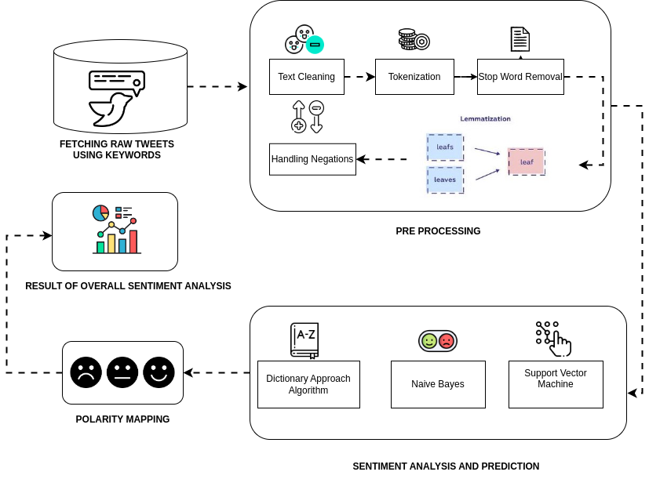
BLOCK DIAGRAM

Slide 5
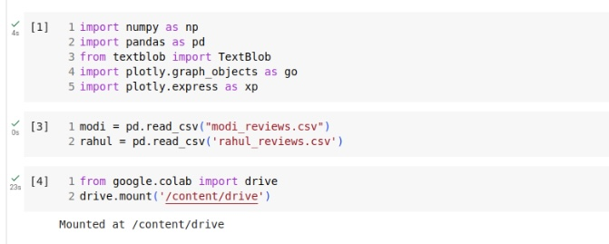
IMPLEMENTATION
Module 1 -Data Collection and Pre-processing
1. Import datasets
https://github.com/pavishek2004/CIP-project/blob/main/modi_reviews.csv
https://github.com/pavishek2004/CIP-project/blob/main/rahul_reviews.csv

Slide 6
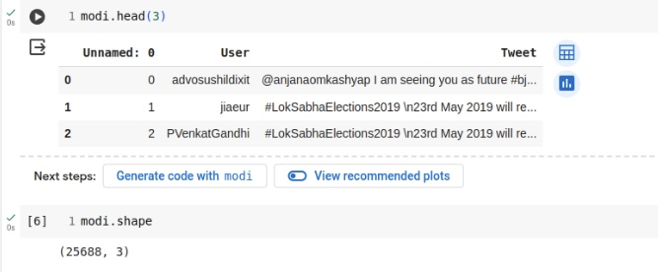
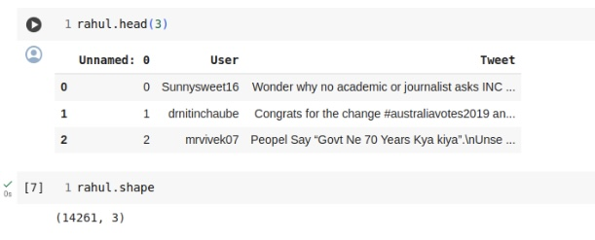
2.Inspecting Dataset

Slide 7
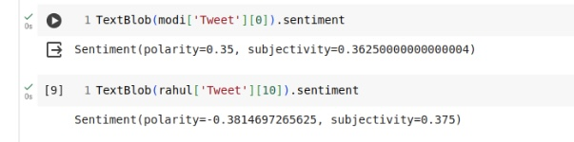
3. Fetching Sentiment Scores of the tweets
Module 2 – Sentinment Analysis

Slide 8
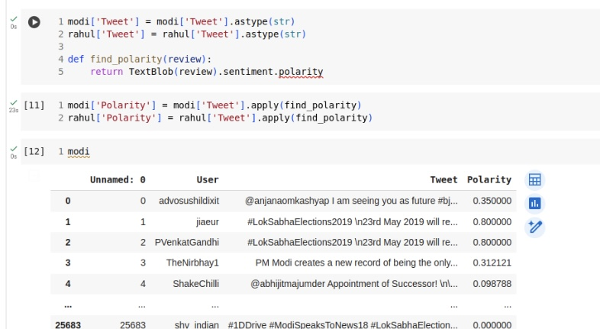
4. Generating the polarity of the tweets

Slide 9
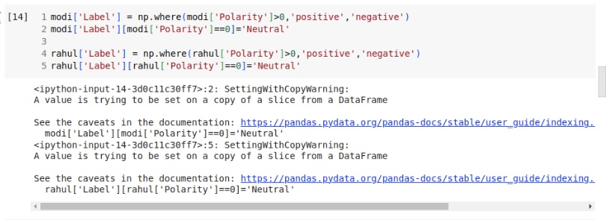
Module 3 – Polarity Mapping
5.Categorizing the tweets based on their polarity

Slide 10
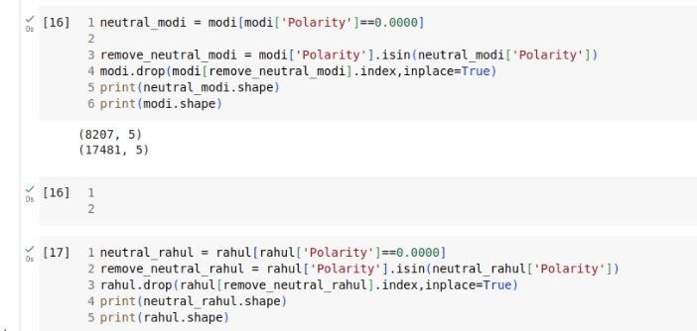
6.Removing Tweets with Neutral Polarity

Slide 11
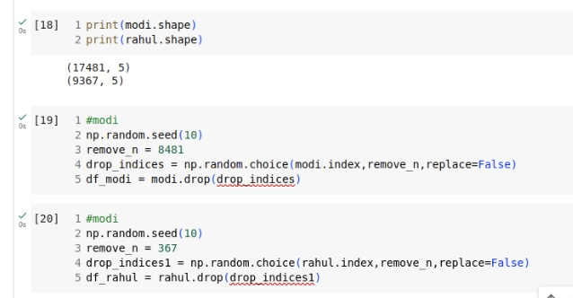
7.Droping the indices of the tweets with Neutral Polarity

Slide 12
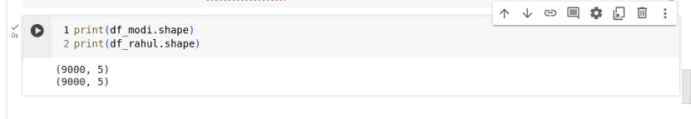
8.Final data set after removing neutral polarity tweets

